Slide 1
Alloys, Eutectics, Azeotropes
We have briefly discussed alloys, or metal
Solid solutions, a couple times in this class so
Far.
Examples:
Stainless steel Fe + (4)-30 wt% Cr
Tool steel Fe + W, Cr, Mo (total up to 30%)
Hastelloy B Fe (5), Ni (63), Mo (28), Co(2), Cr (1)

Slide 2
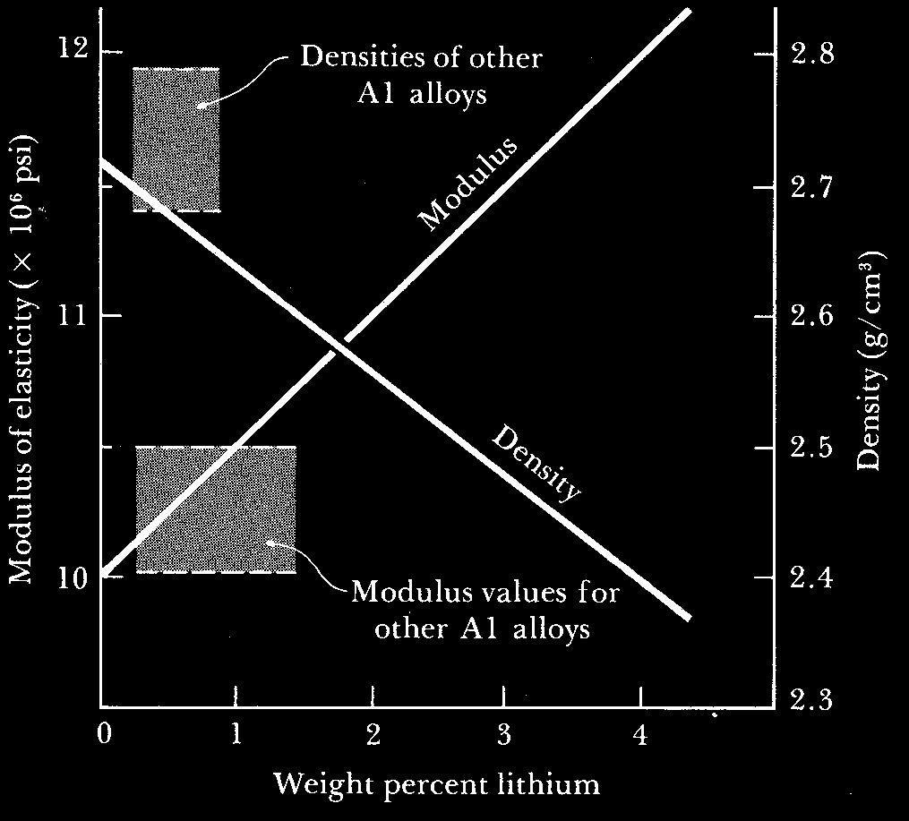
Al-Li Alloys
Various
Sources
From
internet

Slide 3
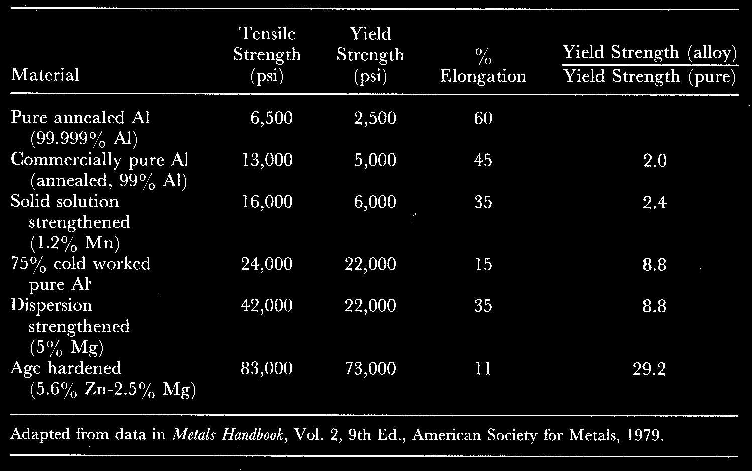
Aluminum alloys

Slide 4
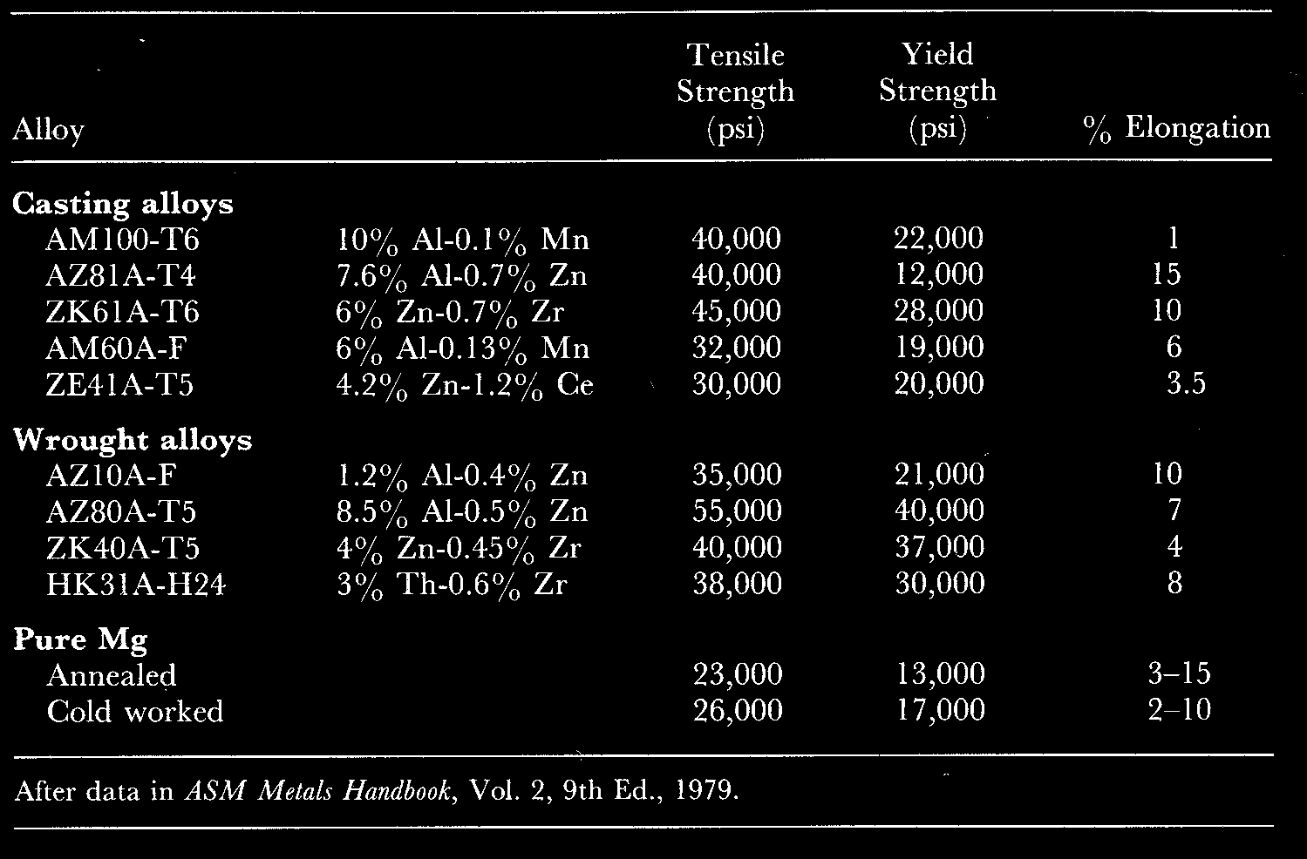
Magnesium alloys

Slide 5
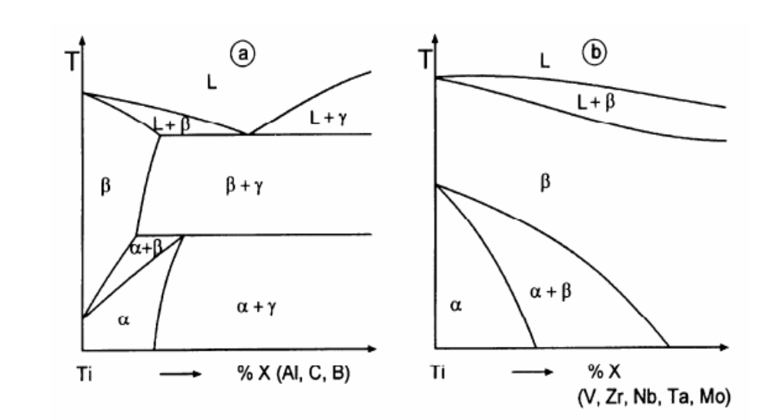
Titanium Alloys
Titanium alloys
Dresden U and U Cambridge
http://www.msm.cam.ac.uk/phase-trans/2005/Air.engines.mpg

Slide 6
Alloys - continued
We have briefly discussed alloys, or metal
Solid solutions, a couple times in this class so
Far.
Ceramics can form alloys too!

Slide 7
We have briefly discussed alloys, or metal
Solid solutions, a couple times in this class so
Far.
Ceramics can form alloys too!
For example. Cr₂O₃ fibers can be used to strengthen
Al₂O₃. These two ceramics are completely miscible
With one another. Al(3+) and Cr(3+) can diffuse into
Each other’s phase. When heated to >2000ºC, the
Strength improved derived from the fibers is lost!

Slide 8
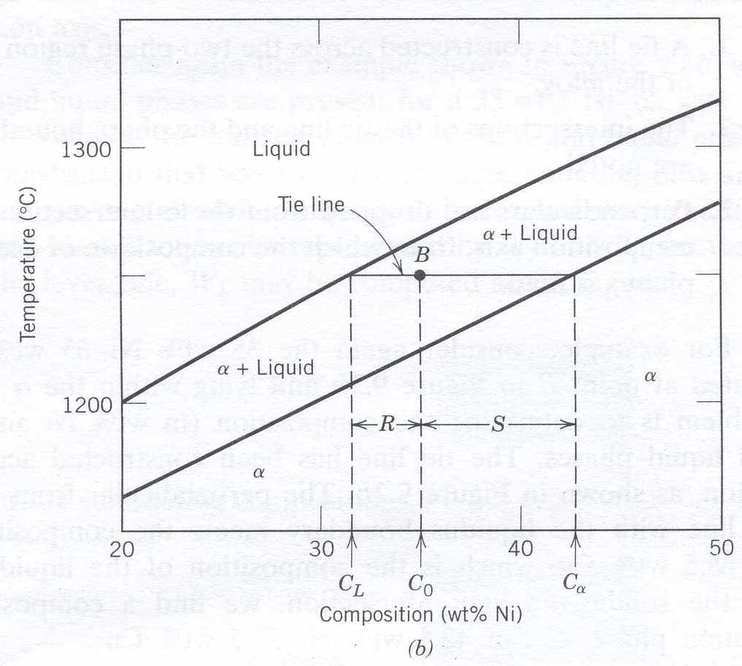
Phase Diagrams - recall
Callister
9.6 Fractions of Phases Present
  Note: Diagram in wt%,
  could be in volume % or mole %
    Liquid Phase C_{L}
    Solid Phase C_{α}
  Lever Rule
Callister Fig. 9.2 a
T

Slide 9
Phase Diagrams - recall
Callister
Callister Fig. 9.2 a
What actually happens
When we take a molten
Liquid containing two or
More components, then
Cool it, passing through
The phase diagram?
T

Slide 10
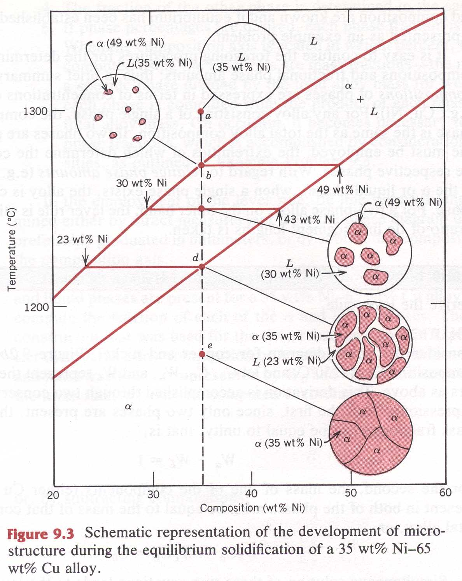
Phase Diagrams
Callister
Microstructure Evolution – Assume Equilibrium Cooling
  Liquid Phase
  Nucleation of Solid
  Growth of Solid in the liquid
  Disappearance of Liquid
  Solid Phase
Callister Fig. 9.3
43% not 49%

Slide 11
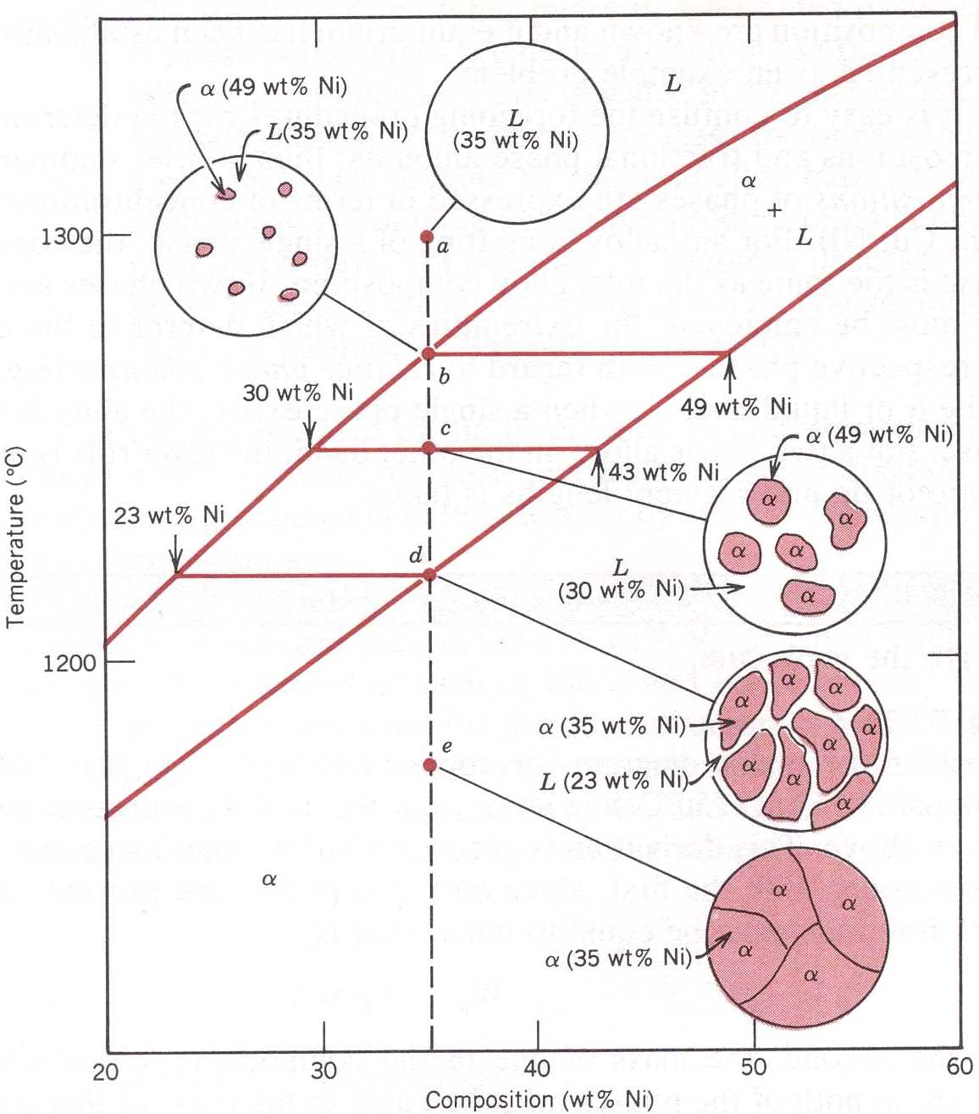
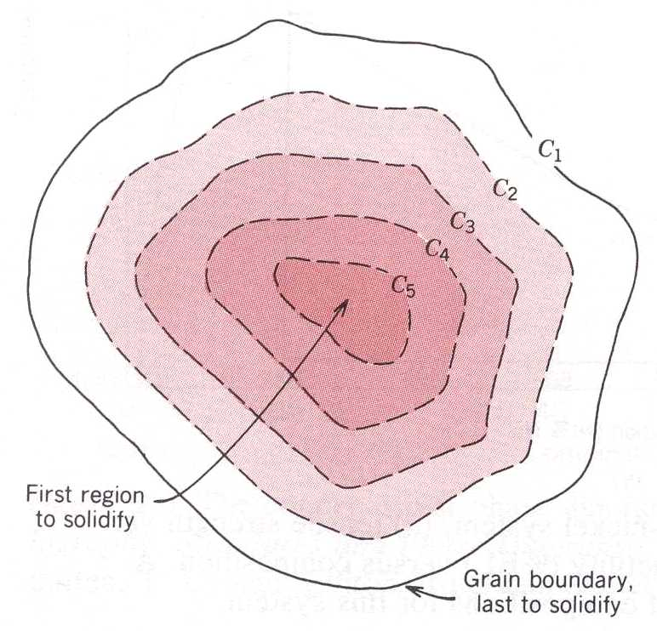
Phase Diagrams
Callister
Microstructure Evolution – Non-Equilibrium Cooling
  The Solid Phase will Change Composition during solidifications (segregation)
Callister Fig. 9.3

Slide 12
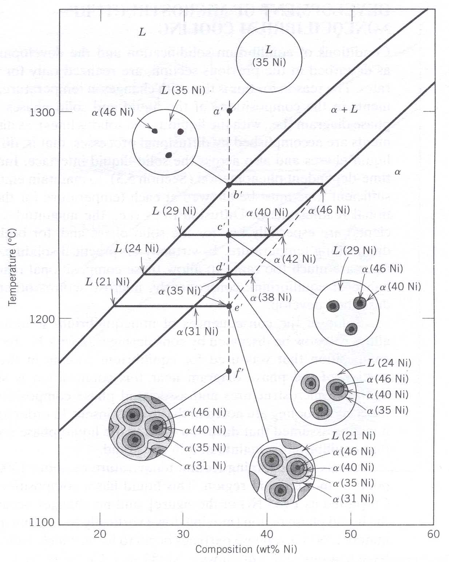
Phase Diagrams
Callister
Microstructure Evolution – Non-Equilibrium Cooling
  Liquid Phase
  Nucleation of Solid
  Growth of Solid in the liquid
  Disappearance of Liquid
  Solid Phase
Callister Fig.

Slide 13
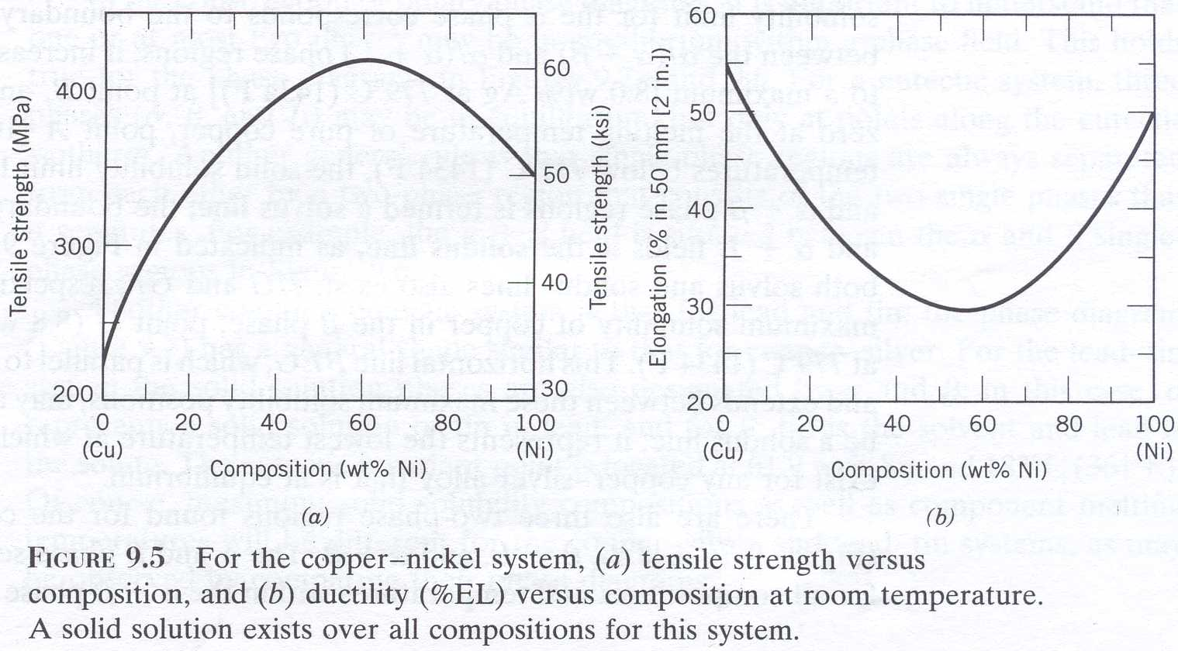
Phase Diagrams
Callister
Microstructure vs. Mechanical Properties
Callister Fig

Slide 14
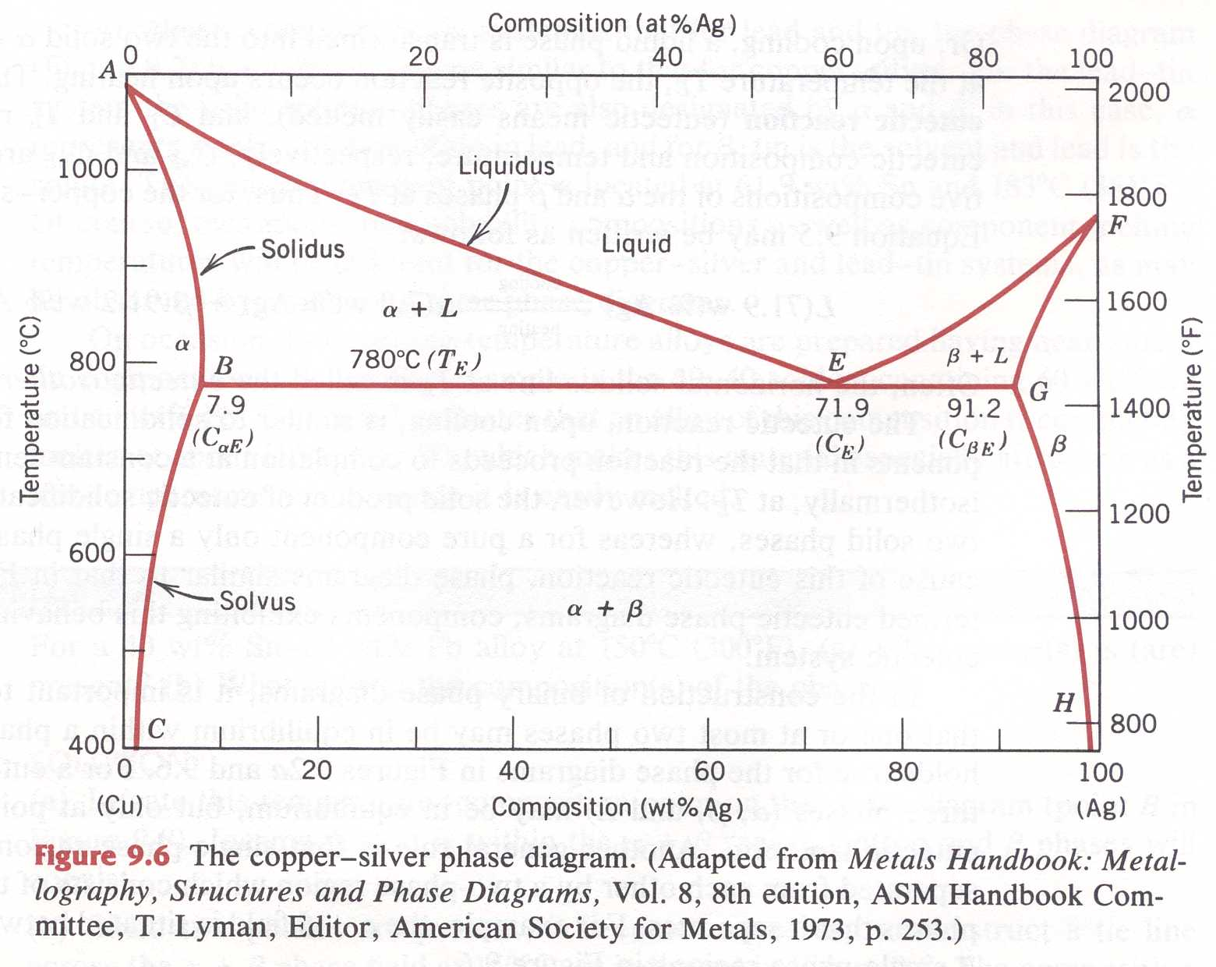
Phase Diagrams
Binary Eutectic Systems [Callister]
A-B Phase Diagram
  Single Phase Fields
    Liquid Phase
    Solid Phase α
    Solid Phase β
  Dual Phase Fields
    Liquid + α
    Liquid + β
    α + β
  Eutectic Point
    Liquid + α + β
    T_{E} and C_{E}
Callister
T_{E}
C_{E}
A
B

Slide 15
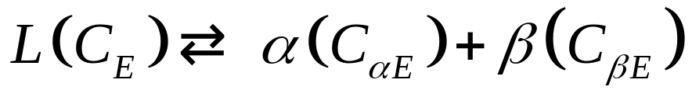
Phase Diagrams
Binary Eutectic Systems [Callister]
Eutectic Reaction
  Cooling
    L → α + β
  Compositions
    C(L)=71.9w/o
    C(α )=7.9w/o
    C(β )=91.2w/o
  Heating
    α + β → L
Callister Fig.

Slide 16
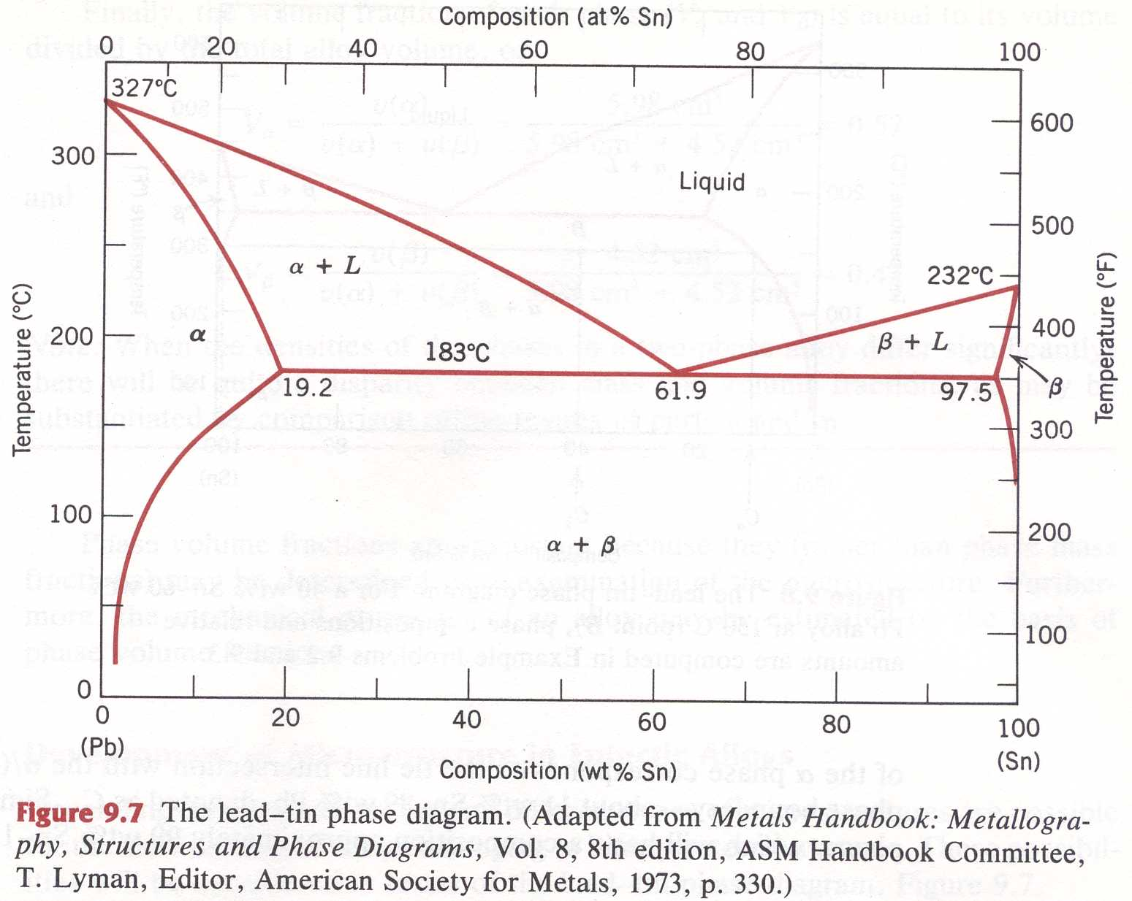
Phase Diagrams
Binary Eutectic Systems [Callister]
Pb – Sn
  Single Phase Fields
    Liquid Phase
    Solid Phase α
    Solid Phase β
  Dual Phase Fields
    Liquid + α
    Liquid + β
    α + β
  Eutectic Point
    Liquid + α + β
    T_{E} and C_{E}
Callister Fig.

Slide 17
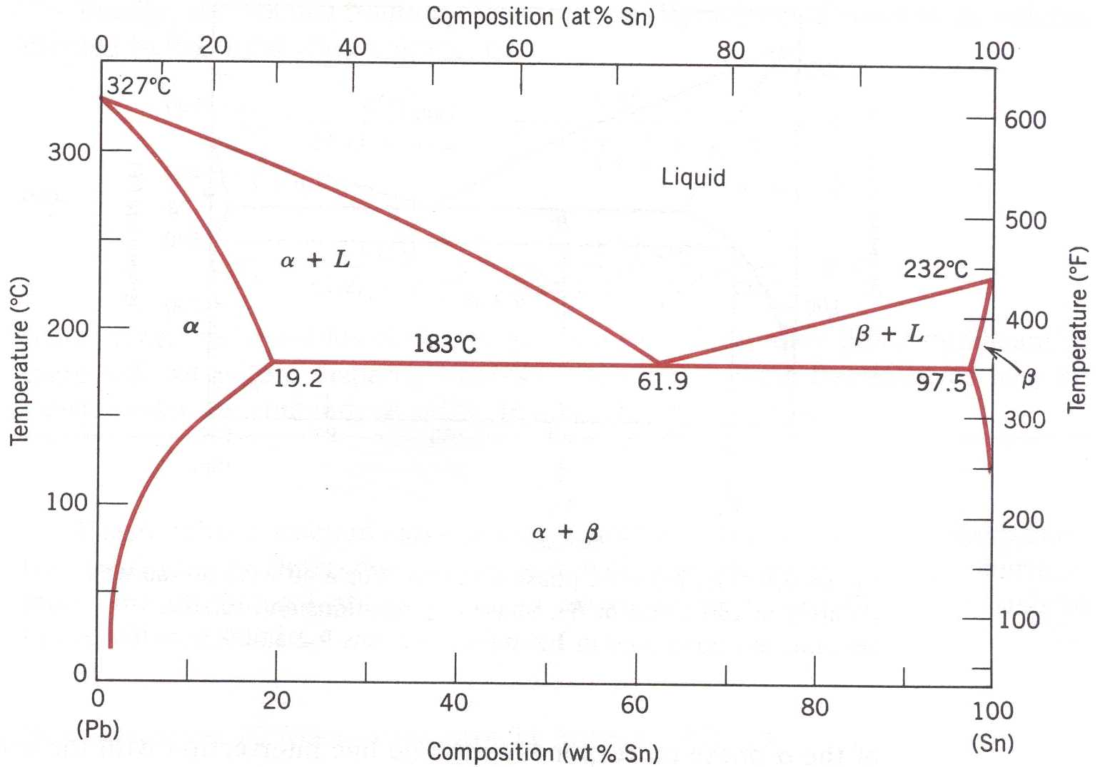
Phase Diagrams
Binary Eutectic Systems [Callister]
Example Problem 9.2
  40 wt% Sn – 60 wt% Pb
  T = 150ºC
  a) Phases present
  b) Compositions
Answer
  C₁
  T = 150ºC
  a) α + β
  b) C(α )=11w/oSn
  C(β )=99w/oSn
Callister Fig.
Note temp
minimia
T=150ºC
C₁

Slide 18
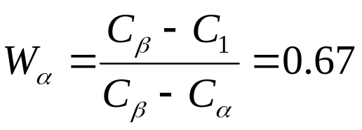
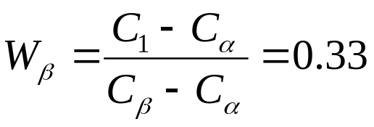
Phase Diagrams
Binary Eutectic Systems [Callister]
Example Problem 9.3
  40 wt% Sn – 60 wt% Pb
  T = 150ºC
  Phase Fractions
Answer
  By weight
Callister Fig.

Slide 19
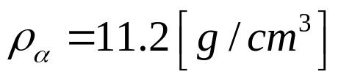
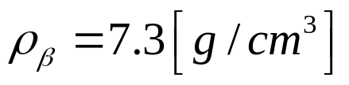
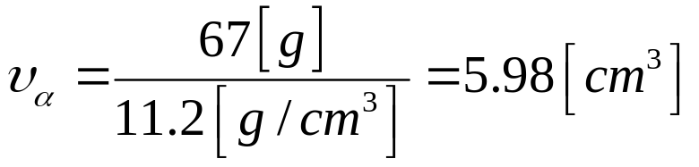
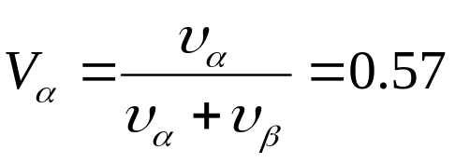
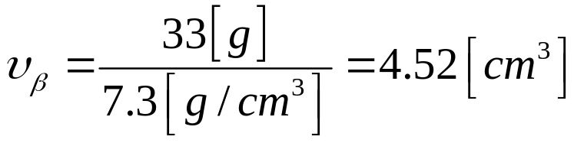
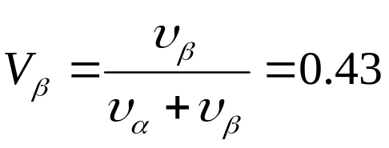
Phase Diagrams
Binary Eutectic Systems [Callister]
Example Problem 9.3
  Phase Fractions
Answer
  By volume
  Use 100g of matter
Callister Fig.

Slide 20
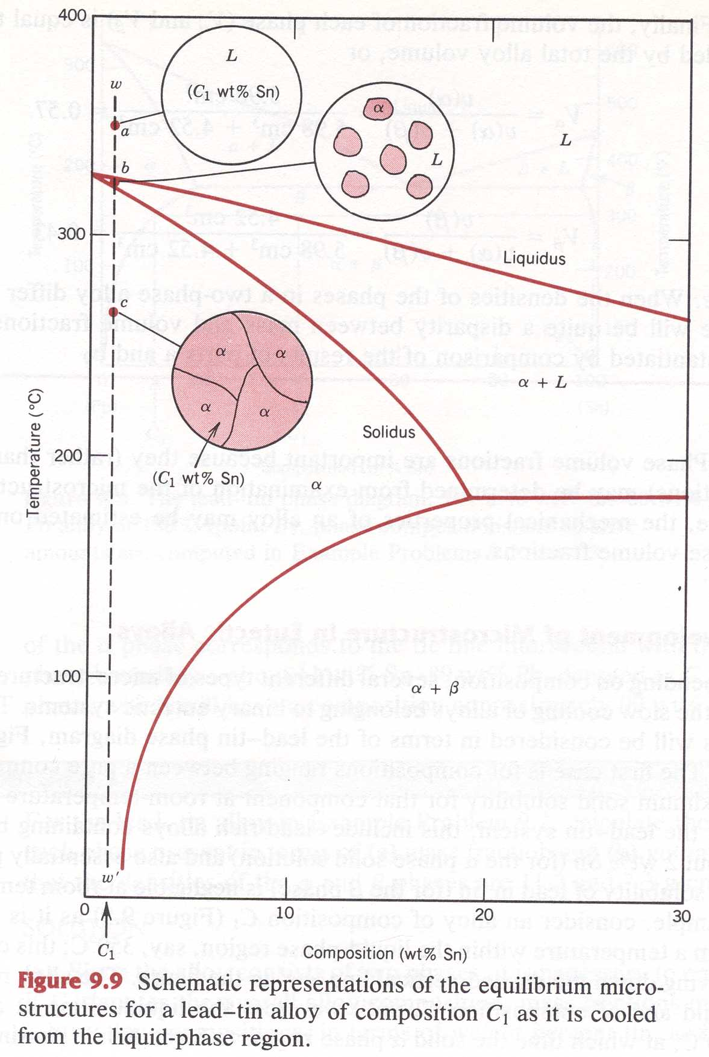
Phase Diagrams
Binary Eutectic Systems [Callister]
Solidification Microstructure
  Pb Rich
    C₁
  α - phase
  Grain growth
Callister Fig. 9.9

Slide 21
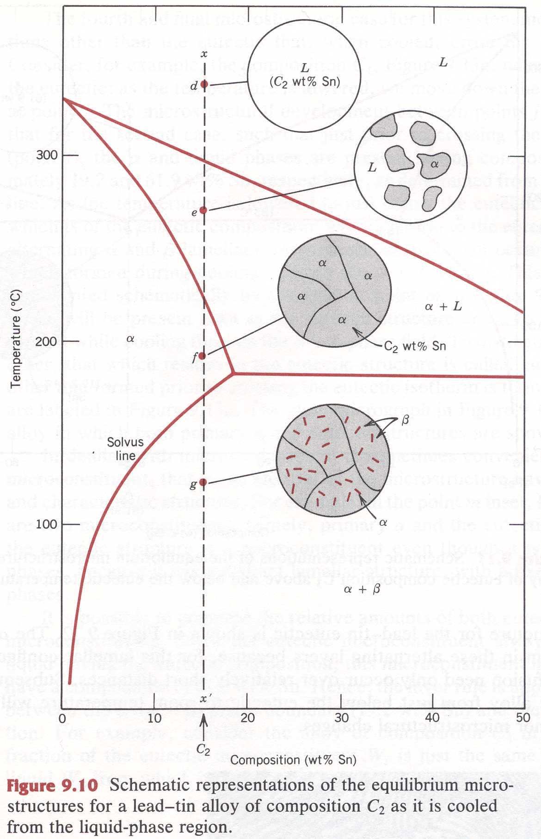
Phase Diagrams
Binary Eutectic Systems [Callister]
Solidification Microstructure
  Pb Rich
    C₂
  α - phase
  Grain growth
  β - phase
    Precipitation within α - grains
Callister Fig. 9.10

Slide 22
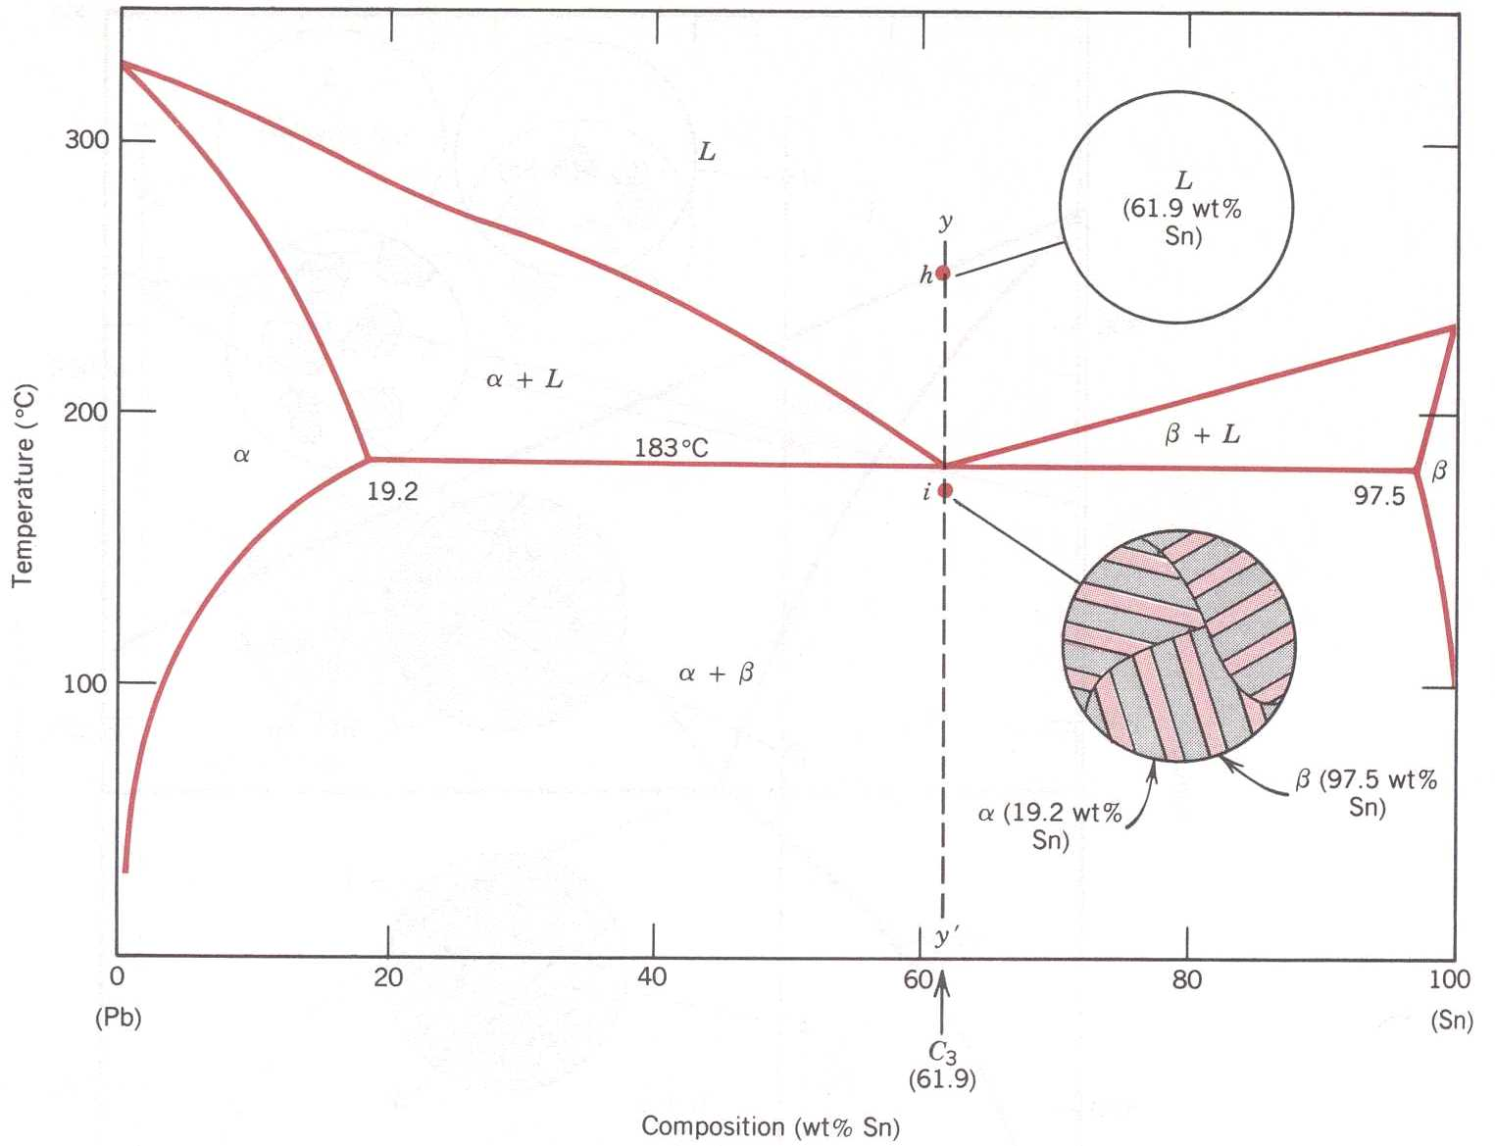
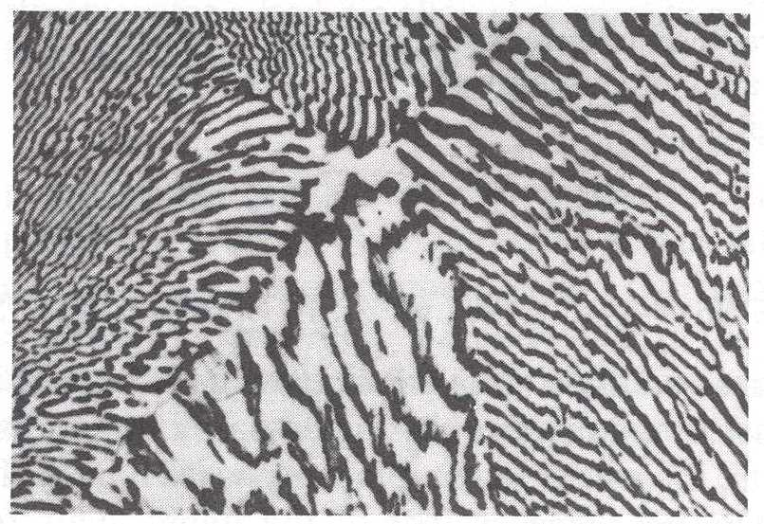
Phase Diagrams
Binary Eutectic Systems [Callister]
Solidification Microstructure
  Eutectic
    C₃ = C_{E}
  α + β phase
  Eutectic Microstructure
  Controlled by Diffusion of Pb and Sn in the Liquid
Callister Fig.
Callister Fig.

Slide 23
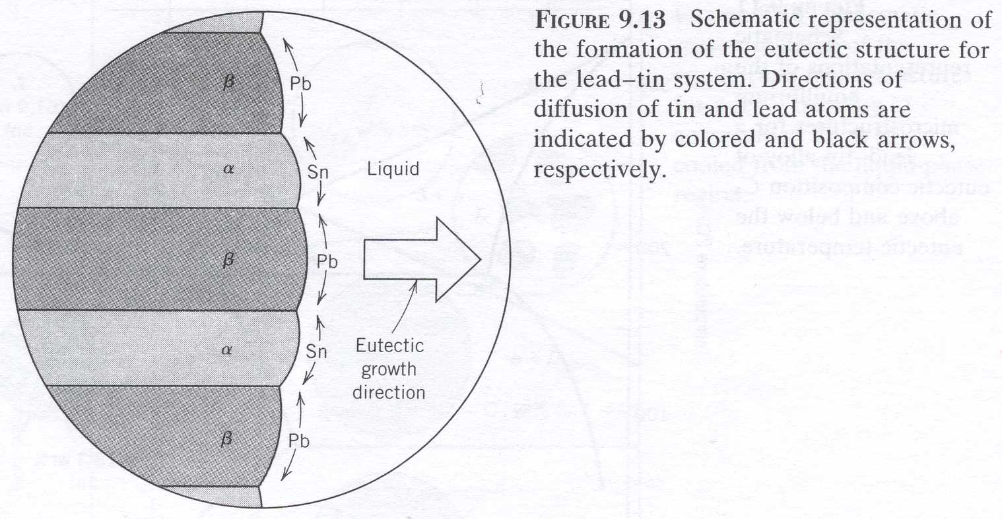
Phase Diagrams
Binary Eutectic Systems [Callister]
Callister Fig.
Callister Fig.
Callister Fig.

Slide 24
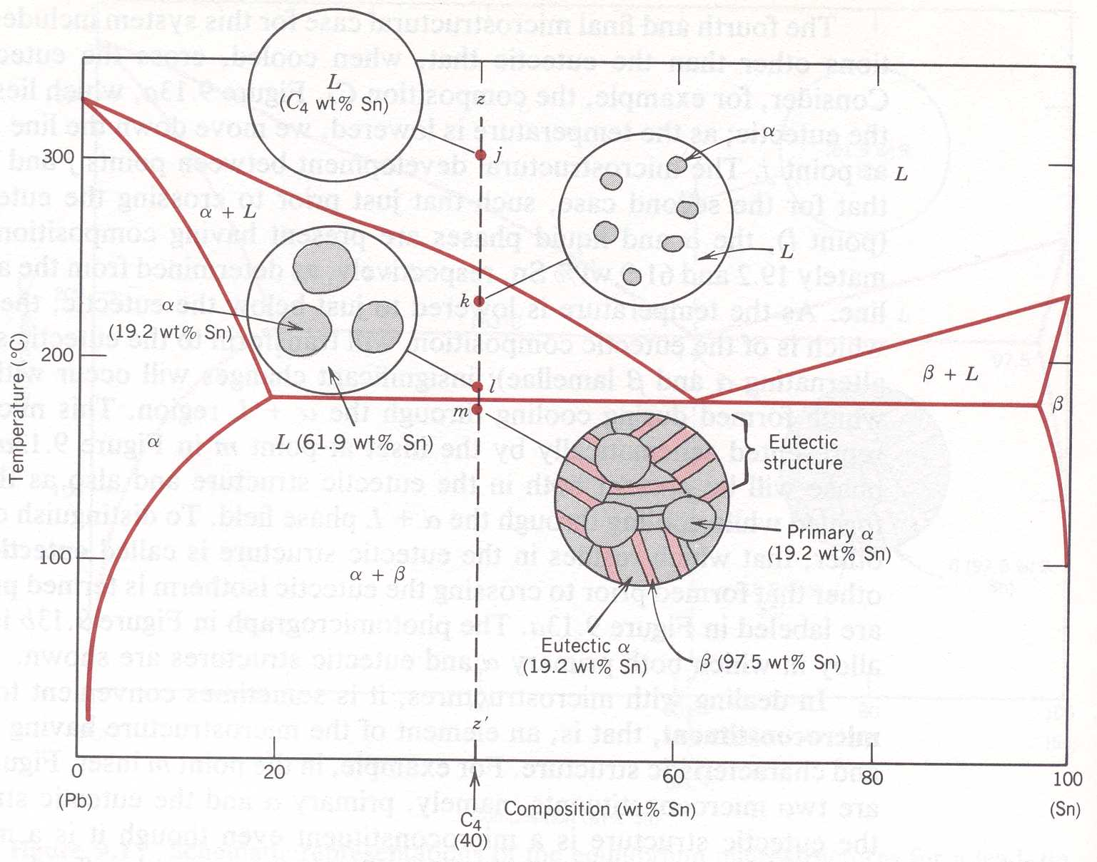
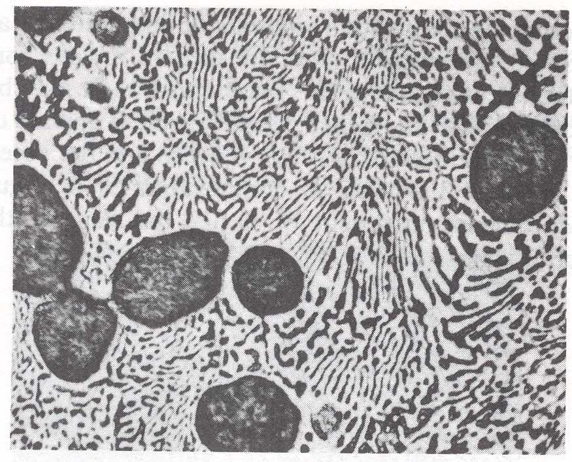
Phase Diagrams
Binary Eutectic Systems [Callister]
Solidification Microstructure
  Sub Eutectic
    C₄ < C_{E}
  α - phase (Primary)
  Eutectic Microstructure
  Controlled by Diffusion of Pb and Sn in the Liquid
Callister Fig.
Callister Fig.

Slide 25
Related to Eutectics
Azeotrope
Sometimes, blends of substances behave like
Discrete, pure substances. These are eutectic
Mixtures
These mixtures will not separate
Example: Ethanol + Water (95/5 wt/wt%)

Slide 26
Sometimes, blends of substances behave like
Discrete, pure substances. These are eutectic
Mixtures
These mixtures will not separate
Example: Ethanol + Water (95/5 wt/wt%)
If you have 98% ethanol/2% water, and heat to
Boiling, pure ethanol will come off until you have
95/5, then that 95/5 will come off

Slide 27
Sometimes, blends of substances behave like
Discrete, pure substances. These are eutectic
Mixtures
These mixtures will not separate
Example: Ethanol + Water (95/5 wt/wt%)
If you have 90% ethanol/10% water, and heat to
Boiling, 95/5 will come off until you have pure
Water left.

